Slide 1

SOCIAL MEDIA WEB
CREATED BY
SANJAY PRAKASH.M
SYED IBRAHIM.S
DHANUSH.C
BARATH RAJ.D

Slide 2

CONTENT
INTRODUCTION
WHAT IS SOCIAL MEDIA
IMPORTANCE OF SOCIAL MEDIA IN OUR LIVES
HOW SOCIAL MEDIA WORKS
TYPES OF SOCIAL MEDIA
ADVANTAGES AND DISADVANTAGE
THANKYOU

Slide 3

INTRODUCTION
Social media is a digital technology that facilitates the sharing of content, multimedia, and information through virtual networks and communities.
There are more than 4.7 billion social media users around the world.
The largest social media platforms are Facebook, YouTube, WhatsApp, Instagram, and WeChat.

Slide 4
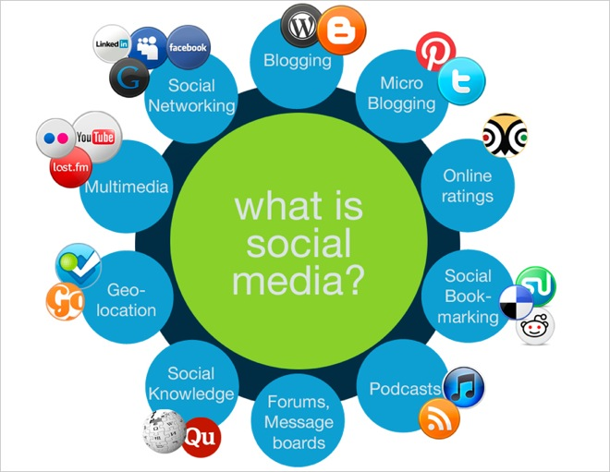
WHAT IS SOCIAL MEDIA
Social media are interactive technologies that facilitate the creation and sharing of information, ideas, interests, and other forms of expression through virtual communities and networks.

Slide 5

IMPORTANCE OF SOCIAL MEDIA IN OUR LIVES
To stay connected with friends and family:
The utmost importance of social media is that it helps in staying in touch with our loved ones.
You get to know what are your friends or family doing.
Even without meeting up too often, social media helps in creating and sustaining that emotional bond.

Slide 6

HOW SOCIAL MEDIA WORKS
Social media platforms allow users to have conversations, share information and create web content.
There are many forms of social media, including blogs, micro-blogs, wikis, social networking sites, photo-sharing sites, instant messaging, video-sharing sites, podcasts, widgets, virtual worlds, and more.

Slide 7

TYPES OF SOCIAL MEDIA
The different types of social media
Traditional social networking sites. like Facebook, Twitter, LinkedIn, and TikTok. ...
Image and video sharing sites. ...
Video hosting sites. ...
Community blogs. ...

Slide 8
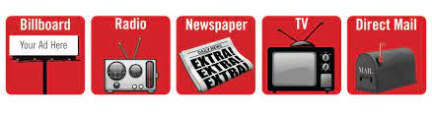
Traditional social networking sites
Most of us are familiar with social networking sites like Facebook, Twitter, LinkedIn, and TikTok. These platforms help us connect with friends, family, and brands. They encourage knowledge-sharing and are all about personal, human-to-human interaction.
A social networking site is a Jill of all trades. Users can share thoughts, curate content, upload photos and videos, form groups based on interests, and participate in lively discussions. They’re built around the user and everything that’s important to them and their social circles.
Also, they help us to measure the social media ROI which helps us in planning an effective marketing strategy.

Slide 9
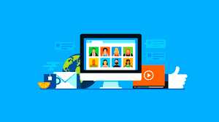
Social review sites
What’s one of the first things you do when planning a trip or buying a new product? If you’re anything like us, you’ll head straight to the reviews.
Review sites like Yelp and Trip Advisor display reviews from community members for all sorts of locations and experiences. This eliminates a lot of the guesswork that goes into booking a restaurant or hotel. Not sure it’s the right thing for you? Check out the reviews and you’ll know.

Slide 10
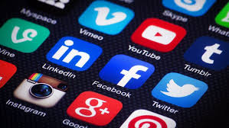
Image and video sharing sites
Visual content like images, infographics, and illustrations capture our hearts, eyes and imaginations. Social media platforms like Instagram, Imgur, and Snapchat are designed to amplify the power of image sharing. (Or these days, video sharing.)
Users create, curate, and share unique content that sparks conversation and speaks for itself. A picture or video can be worth a thousand words to your business.

Slide 11

Video hosting sites
YouTube revolutionized the way we watch, create, and think about video. It transformed the medium into something accessible. Recent improvements in tech and connectivity helped video go the rest of the way.
Video hosting platforms like YouTube and Vimeo help creators put together content and share it to a platform optimized for streaming. This accessibility makes video a super important medium.

Slide 12

Community blogs
Sometimes an image or post isn’t complex enough for the message you’ve got to share, but not everyone on the internet wants to run a blog from a self-hosted website. That’s a lot of work.
Shared blogging platforms like Medium and Tumblr give people a space to express their thoughts and help connect them with readers.
These community blog sites provide an audience while allowing plenty of room for customization and self expression.

Slide 13

Discussion sites
While most of us have seen many a heated discussion happen on Facebook, discussion sites like Reddit and Quora are specifically designed to spark a conversation.
Anyone is free to ask a question or make a statement, and this attracts people with shared interests and curiosities. However, unlike Facebook and Instagram, users tend to give out less identifiable information. Anonymity is powerful when it comes to people opening up and getting real.

Slide 14

Sharing economy networks
Sites like Airbnb and Rover aren’t just a cool place to find cheap holiday rentals or a pet sitter. Sharing economy networks bring people who’ve got something they want to share together with the people who need it.
These communities provide opportunities that won’t exist otherwise by pooling resources on a large scale that wouldn’t be possible without tech.

Slide 15
ADVANTAGES AND DISADVANTAGE
DISADVANTAGES
1. Cyberbullying
2. Hacking on Social Media
3. Reduces Face-to-face Communication Skills
4. Fake News
5. People’s Addiction to Social Media
6. Social Media Is Harmful to One’s Health
7. Spending Time on Social Media is a Waste of Time
ADVANTAGES
1. A Place for Noble Causes and Practices
2. Use of Social Media for Promotion and Advertising
3. People Can Connect Through Social Media
4. Social Media is a Good Source of Up-to-Date Information
5. Social Media Is Beneficial to Education
6. Use Social Media To Drive Traffic To Your Website
7. Social Media Assists in the Formation of People’s Communities

Slide 16

https://github.com/SYEDIBRAHIM21/syed-ibrahim.git

Slide 17
THANK YOU
__________

